Slide 1
Deep dive into debugging your PowerShell scripts
Tyler Leonhardt
❤️
Notes:
This is the slide shown before the presentation starts. When you are ready to go, tell the video operator to start the recording, and click to the next slide.

Slide 2
5
Video operator, did you start the recording?
Notes:
[REQUIRED SLIDE]
These slides are mandatory and help us with video post-processing. Please keep them as they are.

Slide 3
4
Notes:
[REQUIRED SLIDE]

Slide 4
3
Notes:
[REQUIRED SLIDE]

Slide 5
2
Notes:
[REQUIRED SLIDE]

Slide 6
1
Notes:
[REQUIRED SLIDE]

Slide 7
Deep dive into debugging your PowerShell scripts
Tyler Leonhardt
❤️
Notes:
This is your opening. Now the stage is yours!

Slide 8
How to insert your Twitter handle
1. On the Insert tab, select Header & Footer.
2. On the Slide tab, check the Footer box.
3. In the box below Footer, type your Twitter handle (e.g. @PSConfEU).
4. To prevent the footer from appearing on the title slide, check the Don't show on title slide box.
5. Click Apply to All button.

Slide 9

Microsoft
Software Engineer
PowerShell Team
@TylerLeonhardt

Slide 10
This Session
How to…
be immediately affective with debugging PowerShell scripts in VSCode
How to…
customize the PowerShell debugger for your needs
Notes:
Please invest some time to reconsider your session: what is it that audience can get out of it? Try and be as precise as you can. If you are showing solutions, then focus on “how to”. If you present about a general technology, you’ll want to stick to “Be able to” or “Understand why/how”.

Slide 11

Keeps hearing about VSCode debugging
Doesn’t know where to get started

Slide 12
Agenda
Zero config/zero setup debugging
A look at the Debug pane
Pester/psake/InvokeBuild debugging
Dissect the launch.json (debug config)
Remote Development
Debugging C# cmdlets
Notes:
Psconf.eu is about demos and code. Try and minimize use of text slides

Slide 13
Zero config/zero setup debugging
&
A look at the Debug pane

Slide 14
-ISH
Debugging Pester tests

Slide 15
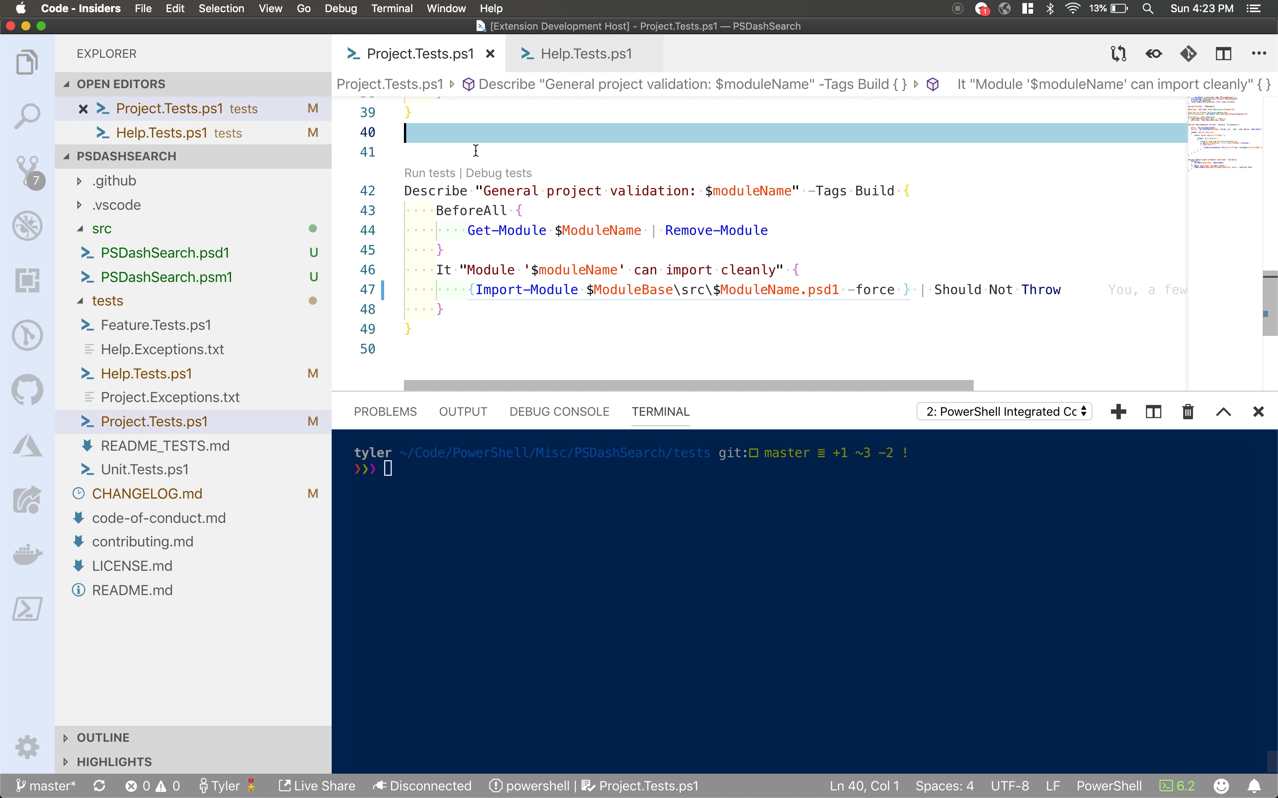

Slide 16
Debugging psake or InvokeBuild tasks

Slide 17
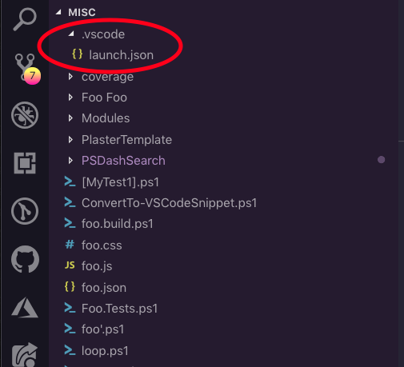
Dissect the launch.json
Sits in the .vscode folder at the root of your workspace.
Contains an array of “launch configs” that control the behavior of the debugger.

Slide 18
Sample launch.json
Key takeaways:
“request” property – can be either “launch” or “attach”
“type” property – must be PowerShell
Most properties are optional.

Slide 19
Launch vs. Attach
Launch:
Run something in the current PowerShell Integrated Console (or start a new PowerShell console).
Attach:
Debug a PowerShell runspace (either in the current process or another PowerShell process).

Slide 20
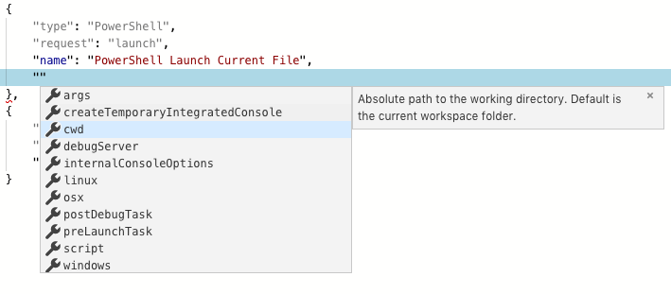
”launch” request

Slide 21
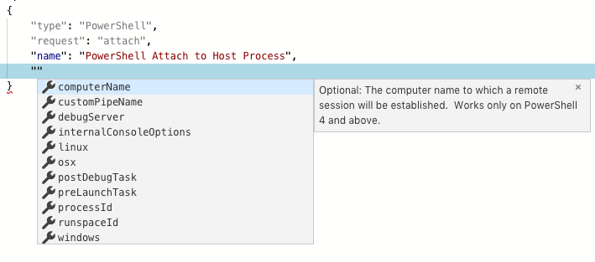
”attach” request
TylerLeonhardt

Slide 22
Built-in launch.json templates

Slide 23
Remote Development
Current experience – built-in to the PowerShell extension
Future experience – The VSCode Remote Development extension

Slide 24
Current remote development experience
Built-in to PowerShell extension for VSCode
Leverages PowerShell remoting (PSRP) via Enter-PSSession
Works cross-platform

Slide 25
Future remote development experience
Remote Development VSCode extension by the VSCode team
Supports remoting over SSH
Also special extensions for Docker containers and Windows Subsystem for Linux (WSL)

Slide 26
Remote debugging

Slide 27
Debugging C# Cmdlets
Use the C# extension for VSCode
Attach to the PowerShell process you will run your cmdlet in
Bonus: Check out Thomas Rayner’s talk on writing C# cmdlets from PSHSummit!

Slide 28
Debugging C# Cmdlets

Slide 29
Summary
How to get started debugging PowerShell scripts in VSCode
How to debug Pester tests and psake and InvokeBuild tasks
How to configure the debugger for advanced usecases
How to do remote editing and debugging
How to debug C# Cmdlets
Notes:
Sum up your key messages

Slide 30
The big slide of links!
PowerShell VSCode docs: https://code.visualstudio.com/docs/languages/powershell
https://docs.microsoft.com/en-us/powershell/scripting/components/vscode/using-vscode
Relevant talks at PSHSummit: “Using VSCode as your default PowerShell editor” by me - https://youtu.be/bGn45vIeAMM
“Writing Compiled PowerShell Cmdlets” by Thomas Rayner - https://youtu.be/O0lk92W799g
Extension links: PS Stable: https://marketplace.visualstudio.com/items?itemName=ms-vscode.PowerShell
PS Preview: https://marketplace.visualstudio.com/items?itemName=ms-vscode.PowerShell-Preview
Remote Development: https://aka.ms/vscode-remote/download/extension
C#: https://marketplace.visualstudio.com/items?itemName=ms-vscode.csharp
TRY THE PREVIEW!

Slide 31
Notes:
[REQUIRED SLIDE]
Make sure you provide all materials that audience needs to reproduce your demos.
Either upload them as a PowerShell module to www.powershellgallery.com (preferred for reusable functions)
Or, upload them to our github repository (ask the girls at the info desk to provide you with access)
Or, upload them to your own github repository
Please make sure all materials are available by the time your presentation starts, or at minimum upload them right after your presentation

Slide 32
Notes:
[REQUIRED SLIDE]
If you sticked to your timing, you now have 15 min left for Q&A. If you missed your timing, you will have to leave the room when your slot is over. In this case, invite your audience to the coffee break and offer to cover questions there.
IN ANY CASE please point your audience to the conference app and the session voting. By the time the conference opens, the eventraft app *should* have the option to vote on sessions.
Please MAKE SURE you leave your room when your slot is over. The next speaker would like to set him/herself up and get everything up and running.

